Slide 1
Using storytelling in the language classroom online workshop with Richard Martin
Workshop aims
Gain confidence to tell freely

Slide 2
Using storytelling in the language classroom online workshop with Richard Martin
Workshop aims
Gain confidence to tell freely
Meet several folk tales to tell in class

Slide 3
Using storytelling in the language classroom online workshop with Richard Martin
Workshop aims
Gain confidence to tell freely
Meet several folk tales to tell in class
Learn where to find more tales and more methodology

Slide 4
Using storytelling in the language classroom online workshop with Richard Martin
Workshop structure
Three blocks
Block 1 – Watching what I do

Slide 5
Using storytelling in the language classroom online workshop with Richard Martin
Workshop structure
Three blocks
Block 1 – Watching what I do
Block 2 – Trying it yourself
Tell your tale to a partner

Slide 6
Using storytelling in the language classroom online workshop with Richard Martin
Workshop structure
Three blocks
Block 1 – Watching what I do
Block 2 – Trying it yourself
Tell your tale to a partner
Block 3 – Using it in class
Methodology

Slide 7
Using storytelling in the language classroom online workshop with Richard Martin
Performance mode - Paralanguage
Body language
Eye contact
Voice

Slide 8
Using storytelling in the language classroom online workshop with Richard Martin
The amateur tells the words

Slide 9
Using storytelling in the language classroom online workshop with Richard Martin
The amateur tells the words
The professional tells the story

Slide 10
Using storytelling in the language classroom online workshop with Richard Martin
The amateur tells the words
The professional tells the story
But the artist tells the listener!

Slide 11

Pausenprogramm (11.30-12.00)
 | Cornelsen | Klett | Westermann
Räume | https://connect.iqsh.de/lft-eng-cornelsen | https://connect.iqsh.de/lft-eng-klett | https://connect.iqsh.de/lft-eng-westermann
11.30 Uhr „Snack“ | Lernen mit Apps: ChatClass – passend zu Access, Lighthouse BuchTaucher – passend zu Sally und Sunshine | Der digitale Unterrichts-assistent von Klett – Ihr wertvoller Begleiter im Distanzunterricht | Kurzpräsentation des digitalen Unterrichts-systems BiBox
im Anschluss | offene Schulberater-sprechstunde | offene Schulberater-sprechstunde | offene Schulberater-sprechstunde
Berater*innen | Anja Baer Michaela Rupp Leana Sklass | Olaf Behrmann Klaus-Dieter Färber | Thomas Berger Ruth von Borck Kezia Raabe

Slide 12
Using storytelling in the language classroom online workshop with Richard Martin
Partner storytelling
Approx. 20 min.
You will be sent to a breakout room with 2 or 3 others who have learnt the same story.
Each time you go to a breakout room, please switch on your video

Slide 13
Using storytelling in the language classroom online workshop with Richard Martin
Partner storytelling
In the breakout room:
Check your understanding of the story

Slide 14
Using storytelling in the language classroom online workshop with Richard Martin
Partner storytelling
In the breakout room:
Check your understanding of the story
Discuss using paralanguage to tell the story

Slide 15
Using storytelling in the language classroom online workshop with Richard Martin
Partner storytelling
In the breakout room:
Check your understanding of the story
Discuss using paralanguage to tell the story
Discuss a good beginning and ending
You do NOT need to agree on any of these points!

Slide 16
Using storytelling in the language classroom online workshop with Richard Martin
Partner storytelling
Approx. 20 min.
You will them be sent to a NEW breakout room with one person who has worked on a different story.
With your video on, tell your new partner your story.
Remember performance mode!
Remember NOT to look at a piece of paper!

Slide 17
Using storytelling in the language classroom online workshop with Richard Martin
Partner storytelling
Glows & Grows
After each story, the listener gives short feedback:
First something positive (to make the teller glow)
Then something to change (to help the teller grow)

Slide 18
Using storytelling in the language classroom online workshop with Richard Martin
Partner storytelling
When you have finished, return to the main meeting.

Slide 19
Pausenprogramm (13.00-14.00)
 | Cornelsen | Klett | Westermann
Räume | https://connect.iqsh.de/lft-eng-cornelsen | https://connect.iqsh.de/lft-eng-klett | https://connect.iqsh.de/lft-eng-westermann
13.00 Uhr „Snack“ | Lernen mit Apps: ChatClass – passend zu Access, Lighthouse BuchTaucher – passend zu Sally und Sunshine | Der Klett eCourse – Unterricht individuell und digital gestalten | Kurzpräsentation des digitalen Unterrichts-systems BiBox
im Anschluss | offene Schulberater-sprechstunde | offene Schulberater-sprechstunde | offene Schulberater-sprechstunde
Berater*innen | Anja Baer Michaela Rupp Leana Sklass | Olaf Behrmann Klaus-Dieter Färber | Thomas Berger Ruth von Borck Kezia Raabe

Slide 20
Using storytelling in the language classroom
online workshop with Richard Martin
Methodology
Some exercises based on my
Activity Teaching Packs
Details on the resources webpage
www.tellatale.eu/workshops/links-05-03.21
20

Slide 21
Using storytelling in the language classroom online workshop with Richard Martin
Vocabulary and discussion
Frightened Mouse
  I want…, Can I…, May I…, Please, may I…, Do you mind if…, I’d like to…,
  Thank you…, Thanks…, That is so kind of you…, I really like that. etc.
Discuss social behaviour – Are please and thank you important?

Slide 22
Using storytelling in the language classroom online workshop with Richard Martin
Picture/text production (for more advanced writing skills)
Students fold a sheet of paper to create 6 boxes. Pictures/words re-tell the story.
Task: Draw the pictures and add some words
Picture 1 | Picture 2 | Picture 3
Picture 4 | Picture 5 | Picture 6

Slide 23
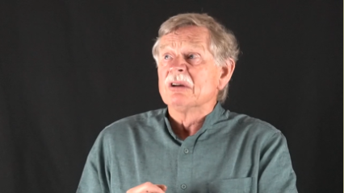
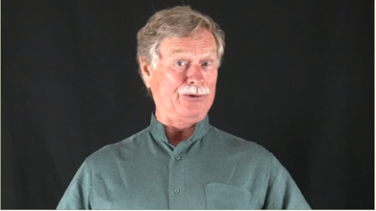
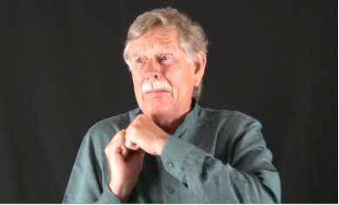
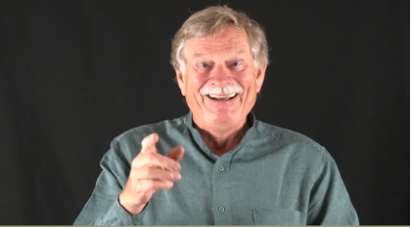
Using storytelling in the language classroom online workshop with Richard Martin
Frightened Mouse: Match the phrases and the screen captures
  He was proud.
  ”Oh, I don’t want to be frightened.”
  He was frightened.
  He has an idea.
1
2
3
4

Slide 24
Using storytelling in the language classroom online workshop with Richard Martin
The Frightened Mouse
The magician advertises his services
Class discussion: How might his advertising poster look
  What image
  What text (headline, strapline, contact details, price)
  Create a poster in class – with as much text as appropriate
  Further discussion: Which other clients come – and why?

Slide 25
Using storytelling in the language classroom online workshop with Richard Martin
Reflection
Class discussion/text production (probably in German rather than in the English lesson)
Many years later, the mouse is now The Wise Mouse. He talks to/writes about this most important experience so the younger generation of mice can learn.
  Discuss in class what he might include: his fear, his pride, the facts of the story, etc.
  If relevant (5th/6th class), what grammar he might use: past tense, negative structures, adjectives, direct speech, recent grammar, etc.
  Class, partner or individual work to write texts (for more advanced writing skills).
  After correction, students can write out a fair copy for classroom display (possibly with illustrations).

Slide 26
Using storytelling in the language classroom online workshop with Richard Martin
Before we end the workshop,
time for feedback
Comment now - or mail to tales@tellatale.eu

Slide 27
Using storytelling in the language classroom online workshop with Richard Martin
Before we end the workshop,
time for feedback
Comment now - or mail to tales@tellatale.eu
How was it for you?

Slide 28
Using storytelling in the language classroom online workshop with Richard Martin
Before we end the workshop,
time for feedback
Comment now - or mail to tales@tellatale.eu
How was it for you?
Did the workshop meet your expectations?

Slide 29
Using storytelling in the language classroom online workshop with Richard Martin
Before we end the workshop,
time for feedback
Comment now - or mail to tales@tellatale.eu
How was it for you?
Did the workshop meet your expectations?

Slide 30
Using storytelling in the language classroom online workshop with Richard Martin
Before we end the workshop,
time for feedback
Comment now - or mail to tales@tellatale.eu
What about these PowerPoint slides?
Did they help?
Were they annoying?
I’d really like to know your views.

Slide 31
Using storytelling in the language classroom online workshop with Richard Martin
And a final thank-you
for joining the workshop
Enjoy your storytelling!
Resource page:
www.tellatale.eu/workshops/links-05-03-21

